Slide 1
GEOG0125
Advanced Topics in Social and Geographic Data Science
Bayesian spatial risk MODELLING IN STAN
Dr Anwar Musah (a.musah@ucl.ac.uk)
Lecturer in Social and Geographic Data Science
UCL Geography
1

Slide 2
Contents
Problem
Hierarchical models and recap
Types of spatial risk estimation
Odds ratios (ORs)
Relative risk ratios (RRs)
Exceedance Probabilities
Spatial intrinsic conditional autoregressive models (iCARs):
Besag-York-Mollie (within an iCAR framework)
Spatial model (with cross-sectional data)
Model formulation from a Bayesian Framework
Examples and interpretation (using Stan)
Alternatives (R-INLA)
Knowledge
Collect
Model
Wrangle
Explore
2

Slide 3
Quick recap on hierarchical regression models
3

Slide 4
Definition:
A hierarchical regression model, are a specialised group of regression-based models that are able to recognise the existence of hierarchies within a data structure and account for them. It is a statistical model used for exploring the relationship between a dependent variable with one or more independent variables while accounting for these hierarchical structures.
Why are hierarchical regression models important:
It is an elegant way to model datasets that have varying scales in their measurements ( - this artefact is caused by the multilevel or hierarchical structure in the dataset)
It is an robust approach for accounting for variations across individual units, and at the same time, the “within-group variations” among groupings
When we are modelling the direct relationship between the level-1 independent variables against the dependent variable, we can allow for direct interactions between level-1 and higher level independent variables that were measured at a group-level
We can quantify group-specific differences as well as group-specific coefficients through the usage of “varying-slopes” or “varying-coefficients”
4

Slide 5








We are Illustrating concisely what we mean by two- or three-level model structure [1]
Group information (level-2)
Group 1
Group 2
Group 3
Group $j$
$$⋯$$
1
2
3
$$⋯$$
$$i$$
1
2
3
$$⋯$$
$$i$$
1
2
3
$$⋯$$
$$i$$
1
2
3
$$⋯$$
$$i$$
Individual information (level-1)
Notes: We have individual units of information that are nested or grouped within a higher measure. This is typically a two-level structure and a two-level hierarchical regression model must be used for this scenario.
5

Slide 6
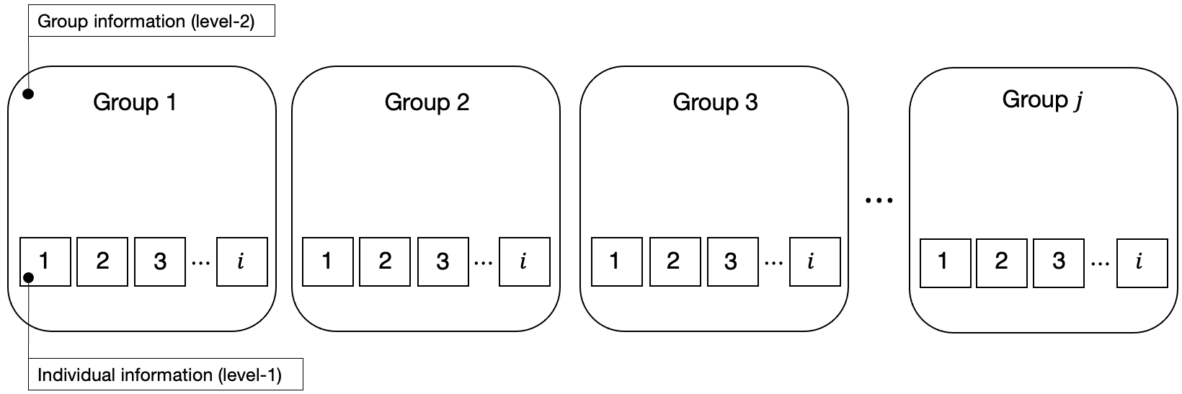


We are Illustrating concisely what we mean by two- or three-level model structure [2]
Higher group information (level-3)
Higher group 1
Higher group 2
Higher group $h$
$$⋯$$
Notes: We have individual units of information that are nested or grouped within a higher measure, where by the same individuals (from the same units) are repeated (i.e., longitudinal). This is typically a three-level structure and so a three-level hierarchical regression model must be used for this scenario.
6
Notes:
Illustrate what these hierarchies are – and then go into why they are important in next slide

Slide 7
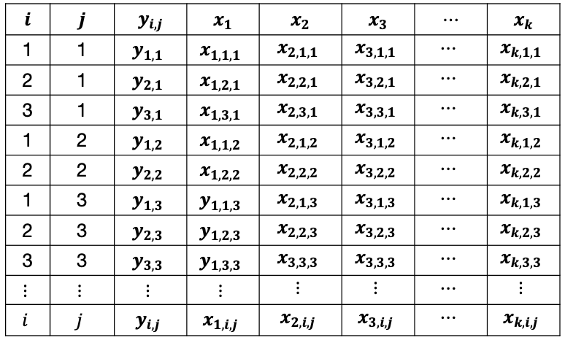
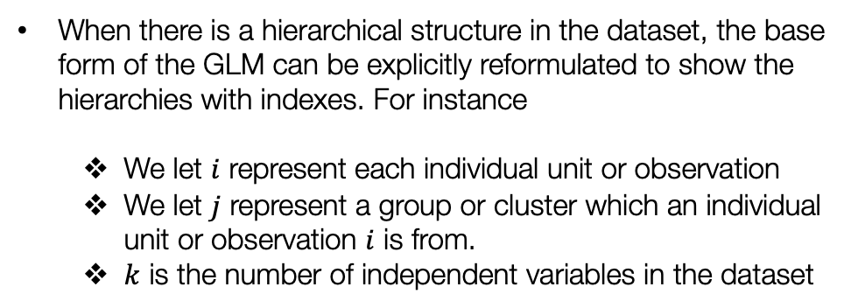
Recall the base model formula for a GLM
$$y= β_{0}+β_{1}x_{1}+β_{2}x_{2}+…+ε$$
Mathematical reformulation of the base GLM regression model using indexes
$$y_{i,j}= β_{0,j}+β_{1,j}x_{1,i,j}+β_{2,j}x_{2,i,j}+…+β_{k,j}x_{k,i,j}+ε_{i,j}$$
When there is a hierarchical structure in the dataset, the base form of the GLM can be explicitly reformulated to show the hierarchies with indexes. For instance
We let $i$ represent each individual unit or observation
We let $j$ represent a group or cluster which an individual unit or observation $i$ is from.
$k$ is the number of independent variables in the dataset
For more information about the above model, refer back to week 7’s lecture notes and video.
7

Slide 8
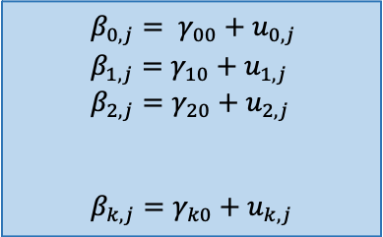

Hierarchical regression model (true form) [1]
$$y_{i,j}= β_{0,j}+β_{1,j}x_{1,i,j}+β_{2,j}x_{2,i,j}+…+β_{k,j}x_{k,i,j}+ε_{i,j}$$
Level 1 Equation
$$β_{0,j}= γ_{00}+u_{0,j}$$
$$β_{1,j}=γ_{10}+u_{1,j}$$
$$β_{2,j}=γ_{20}+u_{2,j}$$
$$β_{k,j}=γ_{k0}+u_{k,j}$$
1st equation is a random-intercept
2nd, 3rd and 4th and so on equations are random-slopes
Level 2 Equations
$$⋮$$
$$⋮$$
$$⋮$$
Note that these equation does not have a two-level independent variable that impacts the outcome
Substitute the level 2 model equations into the level 1 model equation:
$$⇒y_{i,j}=\left(γ_{00}+u_{0,j}\right)+(γ_{10}+u_{1,j})x_{1,i,j}+(γ_{20}+u_{2,j})x_{2,i,j}+…+(γ_{k0}+u_{1,j})x_{k,i,j}+ε_{i,j}$$
After substitution, we expanding the expression and rearrange as follows:
${⇒y}_{i,j} =$ $γ_{00}+γ_{10}x_{1,i,j}+γ_{20}x_{2,i,j}+…+γ_{k0}x_{k,i,j}+$ $u_{0,j}+u_{1,j}x_{1,i,j}+u_{2,j}x_{2,i,j}+…+u_{k,j}x_{k,i,j}+ε_{i,j}$
Model’s true form
Fixed part
Random part
Note: There are model scenarios
$γ_{00}$ is the global intercept from the fixed part of the model we want to report
$γ_{10}, γ_{20}, …and γ_{k0}$ are the coefficients from the fixed part of the model we want to report now
$u_{0,j}, u_{1,j}, u_{2,j}, …and u_{k,j}$ as well as $ε_{i,j}$they have variances for random part of the model we want to report
8

Slide 9


Hierarchical regression (Random-slope) model (true form) [2]
$$y_{i,j}= β_{0,j}+β_{1,j}x_{1,i,j}+β_{2,j}x_{2,i,j}+…+β_{k,j}x_{k,i,j}+ε_{i,j}$$
Level 1 Equation
This is an example of a random-slope model which includes both a random-intercept and random-slopes. This means there group structures causes variation in the means across groups (i.e., intercepts) and slopes
$$β_{0,j}= γ_{00}+u_{0,j}$$
$$β_{1,j}=γ_{10}+u_{1,j}$$
$$β_{2,j}=γ_{20}+u_{2,j}$$
$$β_{k,j}=γ_{k0}+u_{k,j}$$
Level 2 Equations
$$⋮$$
$$⋮$$
$$⋮$$
$y_{i,j} =$ $γ_{00}+γ_{10}x_{1,i,j}+γ_{20}x_{2,i,j}+…+γ_{k0}x_{k,i,j}+$ $u_{0,j}+u_{1,j}x_{1,i,j}+u_{2,j}x_{2,i,j}+…+u_{k,j}x_{k,i,j}+ε_{i,j}$
Model’s true form
Group 2
Fixed part
Random part
Group 1
Group 3
Group 4
9

Slide 10

Hierarchical regression (random-intercept-only) model (true form) [3]
$$y_{i,j}= β_{0,j}+β_{1,j}x_{1,i,j}+β_{2,j}x_{2,i,j}+…+β_{k,j}x_{k,i,j}+ε_{i,j}$$
Level 1 Equation
$$β_{0,j}= γ_{00}+u_{0,j}$$
Level 2 Equation
This is an example of a random-intercept-only model which only includes a random-intercept and excludes the random-slopes. This means that the group structure causes variation on the means (i.e., group-specific intercepts) but not on slopes
Here, the model is much simpler:
$y_{i,j} =$ $γ_{00}+β_{1,j}x_{1,i,j}+β_{2,j}x_{2,i,j}+…+β_{k,j}x_{k,i,j}{+ u}_{0,j}+ ε_{i,j}$
Model’s true form
Fixed part
Random part
Group 1
Group 2
Group 3
Group 4
10

Slide 11



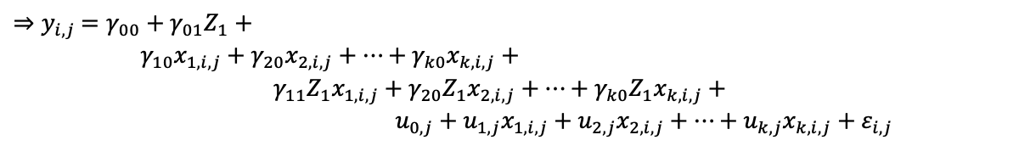

Hierarchical regression (random coefficients) model (true form) [4]
$$y_{i,j}= β_{0,j}+β_{1,j}x_{1,i,j}+β_{2,j}x_{2,i,j}+…+β_{k,j}x_{k,i,j}+ε_{i,j}$$
Level 1 Equation
$${ β}_{0,j} = γ_{00}+{γ_{01}Z_{1}+u}_{0,j}$$
$$β_{1,j}=γ_{10}+γ_{11}Z_{1}+u_{1,j}$$
$$β_{2,j}=γ_{20}+γ_{21}Z_{1}+u_{2,j}$$
$$β_{k,j}=γ_{k0}+γ_{k1}Z_{1}+u_{k,j}$$
Suppose we have an independent variable measure on the group-level impacting our outcome on the individual-level.
Level 2 Equations
$$⋮$$
$$⋮$$
$$⋮$$
$$⋮$$
Substitute the level 2 model equations with the variables into the level 1 model equation:
$$⇒y_{i,j}=\left(γ_{00}+{γ_{01}Z}_{I}+{ u}_{0,j}\right)+(γ_{10}+{γ_{11}Z}_{I}+u_{1,j})x_{1,i,j}+(γ_{20}+{γ_{21}Z}_{I}+u_{2,j})x_{2,i,j}+…+(γ_{k0}+{γ_{k1}Z}_{I}+u_{1,j})x_{k,i,j}+ε_{i,j}$$
After substitution, we expanding the expression and rearrange as follows:
$γ_{00}$ is the global or population mean
${⇒y}_{i,j} =$ $γ_{00}+{γ_{01}Z}_{1}+$
$γ_{10}x_{1,i,j}+γ_{20}x_{2,i,j}+…+γ_{k0}x_{k,i,j}+$
$γ_{11}{Z_{1}x}_{1,i,j}+γ_{20}{Z_{1}x}_{2,i,j}+…+γ_{k0}{Z_{1}x}_{k,i,j}+$
$u_{0,j}+u_{1,j}x_{1,i,j}+u_{2,j}x_{2,i,j}+…+u_{k,j}x_{k,i,j}+ε_{i,j}$
$γ_{01}$ is the random coefficient for $Z_{1}$
These are fixed effects coefficients for the variables in the level 1 equation
These are random coefficients for the interacting variables from the level 1 & 2 equation
Model’s true form
These are the random effects
11

Slide 12




Situating hierarchical models within a spatial context:
Bayesian inference, are often used in hierarchical modelling, which are models commonly used in the quantification of spatial and spatiotemporal areal data.
Bayesian approach are incredibly good with datasets that have a hierarchical structure.
These are statistical model written in multiple levels (i.e., hierarchical form) to estimate parameters of the posterior distribution
Example: Intestinal parasitaemia among school children in Tanzania and infection status linked with anaemia
$$x_{1},y_{1}$$
$$x_{2},y_{2}$$
$$x_{3},y_{3}$$
$$x_{n},y_{n}$$
…
School 1
School 2
School 3
School n
12
Notes:
Bayesian inference with a

Slide 13
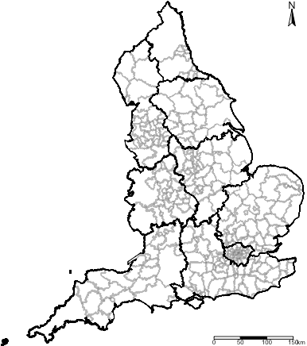




Level 2:
$$t=2019$$
$$t=2020$$
$$t=2021$$
$$t=2022$$
Level 1:
These models allow complete flexibility in the estimation of risks - allowing the user to account for space-time interactions
You can make the model (in contrast to frequentist) to borrow strength across space-time, in order to improve estimation and prediction of an underlying model’s feature
13

Slide 14
Type of spatial risk estimation
14

Slide 15
Areal data
Areal, or lattice data arise when dealing with a fixed domain that is partitioned to a finite number of sub-regions at which outcome can be aggregated too
Examples of areal data are:
Number of cancer cases in counties
Number of road accidents in districts
Proportion of people living in poverty in postcode block etc.
Often, risk models aim to obtain such estimates within such areas where data is available. We can use Bayesian Hierarchical Models in this context, depending on the type of study design, to estimate the following: Odds Ratios (ORs) or Relative Risk (RRs)
15
Notes:
Bayesian inference with a

Slide 16
Interpretation of Risk Ratios (RR)
RR= 1 (null value), it means that independent variable has no effect on the outcome
RR < 1, the independent variable has an impact on the outcome – in this case, its reduced effect, or reduced risk on the outcome
RR > 1, the independent variable has an impact on the outcome – and so, in this case, its increased effect, or increased risk on the outcome
From hazards models:
Cox Proportional Hazards model
Any Poisson model
16

Slide 17
Interpretation of Odds Ratios (OR)
OR = 1 (null value), it means that independent variable has no effect on the outcome
OR < 1, the independent variable has an impact on the outcome – in this case, its reduced effect, or reduced risk on the outcome
OR > 1, the independent variable has an impact on the outcome – and so, in this case, its increased effect, or increased risk on the outcome
From models:
Binary or Binomial regression model
17

Slide 18
Exceedance Probability
Exceedance Probabilities (or Marginals) is a statistical measure describing the probability that an estimated risk value for an areal-unit exceeds a given threshold.
A common example used in every day application are disease risk models, we are usually concerned about areas that have excess risk of a disease type i.e., P(RR > 1)
In epidemiology, the Exceedance Probabilities have been operationalised to detect clusters of areas with exceedingly higher risk of a disease (or adverse event).
18

Slide 19
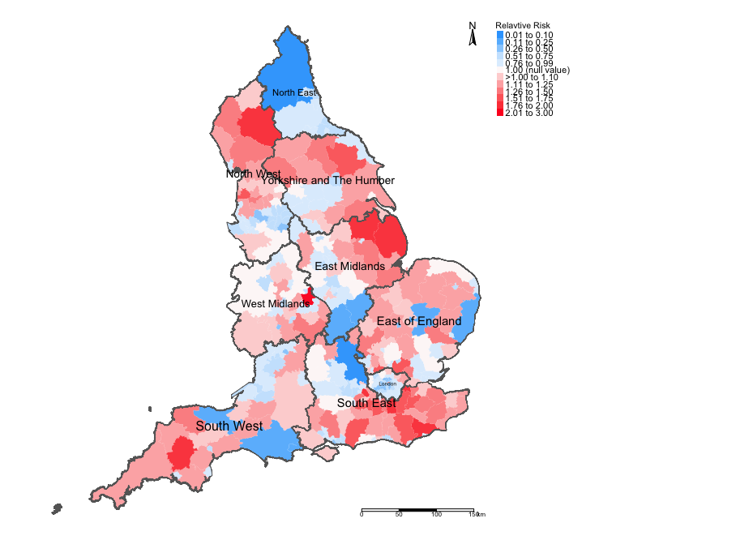
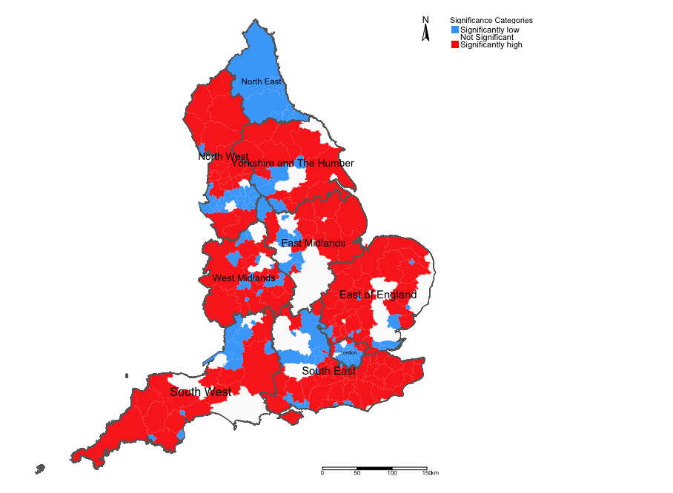
Example: Risks of Road-related casualties in England 2015-2020 [1]
Relative Risks (RR)
Overall significance (95% Credibility Intervals)
19

Slide 20
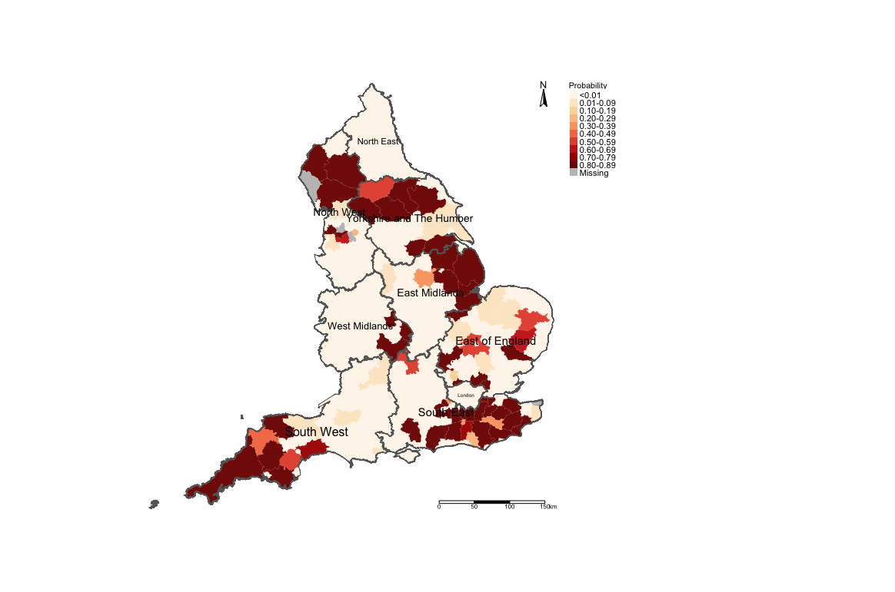
Example: Risks of Road-related casualties in England 2015-2020 [2]
The areas in darker reds are perhaps priority areas for some road safety policy should be implemented?
Exceedance Probability i.e., Pr(RR > 1.40) (i.e., risk are 40% higher than expected)
20

Slide 21
Spatial Intrinsic Conditional Autoregressive models (iCARs)
21

Slide 22
Besag-York-Mollie (BYM) (or CAR models)
This is a popular spatial model which takes into account that the data may potentially be spatially correlated and the observations in the neighbouring areas may be more similar than observations in areas that are distant from each other.
This is a type of hierarchical model which includes a spatial random effect,
It is heavy dependent on neighbourhood adjacency matrix
There are two versions of this model:
BYM model that has a spatial effect term only that’s treated a smoothing term (multiplied by an error term)
BYM model that has both a spatial effect term which is treated a structured random effect, and the error term is an unstructured noise
When fitting data to this type of model – the best choice of the likelihood function (i.e., statistical model) is Poisson (i.e., aggregated counts to areas).
22
Notes:
Bayesian inference with a

Slide 23
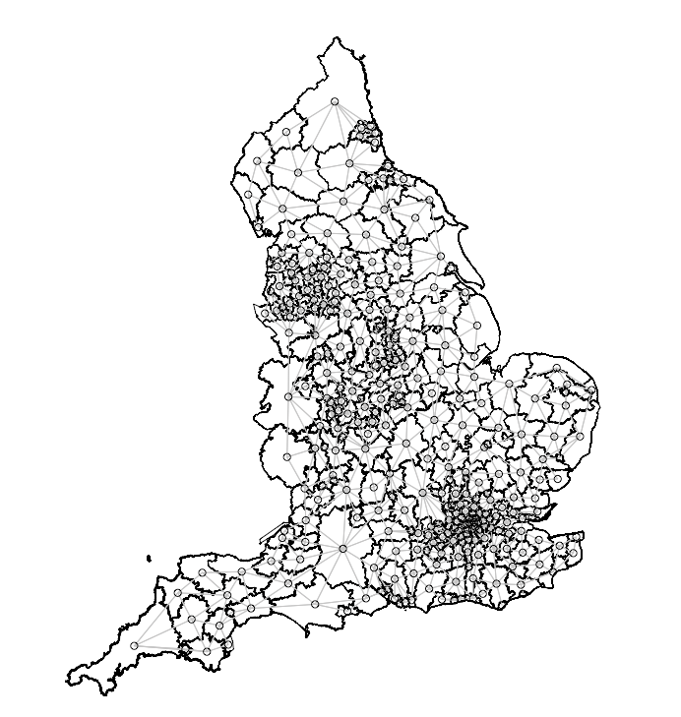
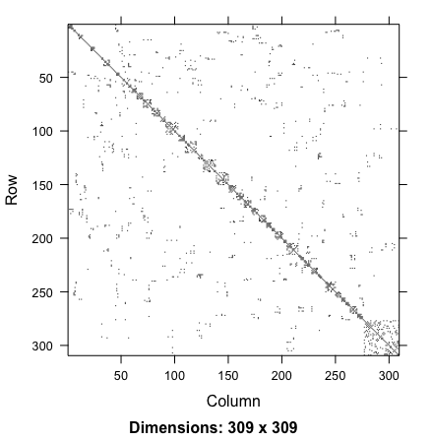
Geographically accurate
neighbourhood structure
Adjacency matrix translated to
graph format
Adjacency matrix translated to
nodes and edge format
Stan only uses the nodes and edges format to reconstruct the adjacency matrix
23

Slide 24
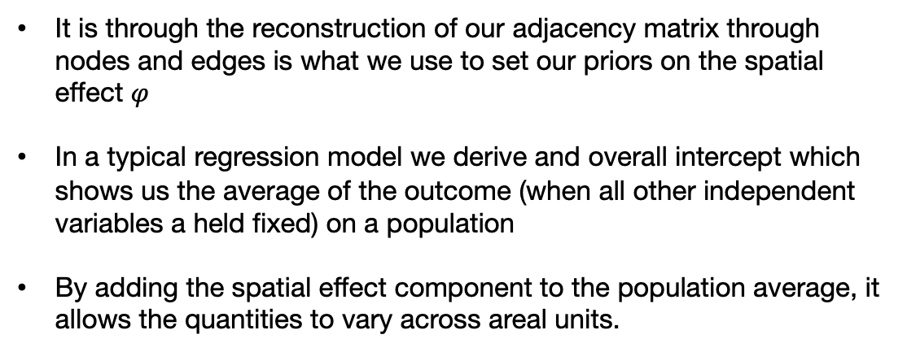
Adding the spatial effect component to the model
It is through the reconstruction of our adjacency matrix through nodes and edges is what we use to set our priors on the spatial effect $φ$
In a typical regression model we derive and overall intercept which shows us the average of the outcome (when all other independent variables a held fixed) on a population
By adding the spatial effect component to the population average, it allows the quantities to vary across areal units.
In Stan:
functions {
real icar_normal_lpdf(vector phi, int N, array[] int node1, array[] int node2) {
return -0.5 * dot_self(phi[node1] - phi[node2]);
}
Node1 is the index area of interest;
Node2 is the neighbouring areas connected to the index area defined in Node1.
N is the total number of areas.
Adjacency matrix translated to nodes and edge format
Prior: $φ\sim icar normal(N, nodes1, nodes2)$ (Specified in the model block)
24
Notes:
We need to create a function for the ICAR component in our model to define the prior of spatial random effect.
This is essentially a probability density computed from the sum of the squared pairwise differences between the spatial effect in area ϕi against another ϕjϕj. This bit is also a reconstruction for the adjacency matrix.
he following program fragment shows the Stan parameter and model block to compute the spatial effects vector through the statement phi ~ icar_normal(N, node1, node2)

Slide 25
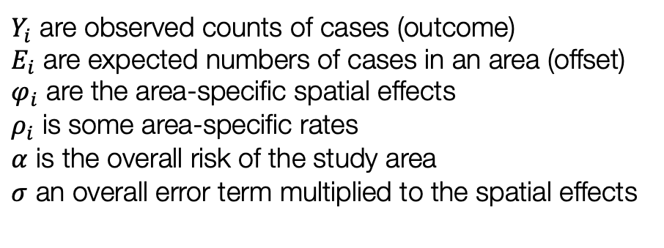
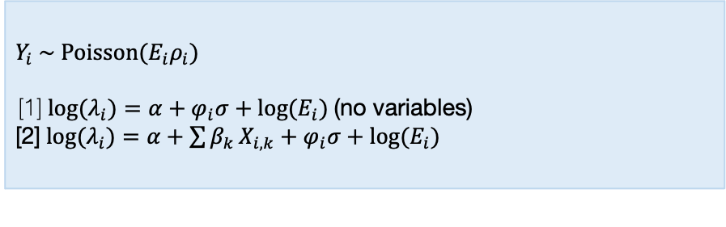
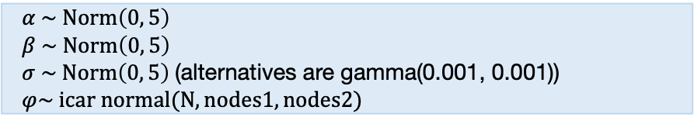
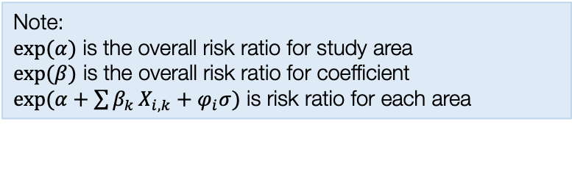
Model formulation from a Bayesian framework
Model components
Specify likelihood function. The outcome is often counts – thus it will be Poisson (with log as the link function).
$Y_{i}$ are observed counts of cases (outcome)
$E_{i}$ are expected numbers of cases in an area (offset)
$φ_{i}$ are the area-specific spatial effects
$ρ_{i}$ is some area-specific rates
$α$ is the overall risk of the study area
$σ$ an overall error term multiplied to the spatial effects
$Y_{i} \sim Poisson(E_{i}ρ_{i})$
[1] ${log⁡(λ}_{i})=α+φ_{i}σ+log(E_{i})$ (no variables)
[2] ${log⁡(λ}_{i})=α+\sum{β_{k}}X_{i,k}+φ_{i}σ+log(E_{i})$
Define the priors for the intercept, coefficients and spatial effects as with an ICAR specification
$α \sim Norm\left(0, 5\right)$
$β \sim Norm\left(0, 5\right)$
$σ \sim Norm\left(0, 5\right)$ (alternatives are gamma(0.001, 0.001))
$φ\sim icar normal(N, nodes1, nodes2)$
Build Bayesian model
Note:
$exp⁡(α)$ is the overall risk ratio for study area
$exp⁡(β)$ is the overall risk ratio for coefficient
$exp(α+\sum{β_{k}}X_{i,k}+φ_{i}σ)$ is risk ratio for each area
Recall the Bayes’ Rule: $P\left(θ | Y\right)∝P\left(Y | θ\right)P(θ)$
$$P\left(α, β_{k}, σ, φ_{i} | { λ}_{i}\right)∝P\left({ λ}_{i} | α, β_{k}, σ, φ_{i}\right) P\left(α\right)P\left(β_{k}\right)P\left(σ\right)P(φ_{i})$$
25

Slide 26
Model formulation from a Bayesian framework
Stan code
functions {
real icar_normal_lpdf(vector phi, int N, array[] int node1, array[] int node2) {
return -0.5 * dot_self(phi[node1] - phi[node2]);
}
}
data {
int<lower=0> N;
int<lower=0> N_edges;
array[N_edges] int<lower=1, upper=N> node1;
array[N_edges] int<lower=1, upper=N> node2;
array[N] int<lower=0> Y;
vector<lower=0>[N] E;
}
transformed data {
vector[N] log_offset = log(E);
}
parameters {
real alpha;
real<lower=0> sigma;
vector[N] phi;
}
model {
phi ~ icar_normal(N, node1, node2);
Y ~ poisson_log(log_offset + alpha + phi*sigma);
alpha ~ normal(0.0, 1.0);
sigma ~ normal(0.0, 1.0);
sum(phi) ~ normal(0, 0.001*N);
}
generated quantities {
vector[N] eta = alpha + phi*sigma;
vector[N] mu = exp(eta);
}
Specify likelihood function. The outcome is often counts – thus it will be Poisson (with log as the link function).
$Y_{i} \sim Poisson(E_{i}ρ_{i})$
[1] ${log⁡(λ}_{i})=α+φ_{i}σ+log(E_{i})$ (no variables)
[2] ${log⁡(λ}_{i})=α+\sum{β_{k}}X_{i,k}+φ_{i}σ+log(E_{i})$
Define the priors for the intercept, coefficients and spatial effects as with an ICAR specification
$α \sim Norm\left(0, 5\right)$
$β \sim Norm\left(0, 5\right)$
$σ \sim Norm\left(0, 5\right)$ (alternatives are gamma(0.001, 0.001))
$φ\sim icar normal(N, nodes1, nodes2)$
Build Bayesian model
Recall the Bayes’ Rule: $P\left(θ | Y\right)∝P\left(Y | θ\right)P(θ)$
$$P\left(α, β_{k}, σ, φ_{i} | { λ}_{i}\right)∝P\left({ λ}_{i} | α, β_{k}, σ, φ_{i}\right) P\left(α\right)P\left(β_{k}\right)P\left(σ\right)P(φ_{i})$$
26

Slide 27
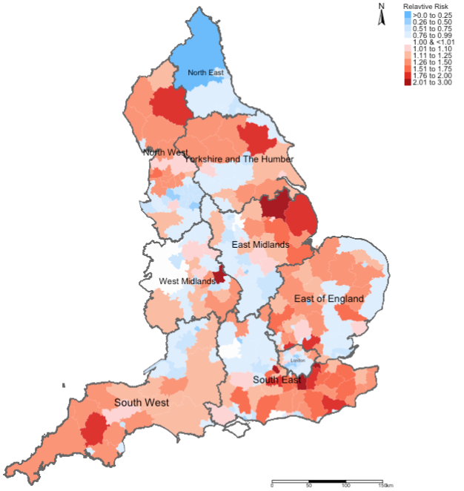
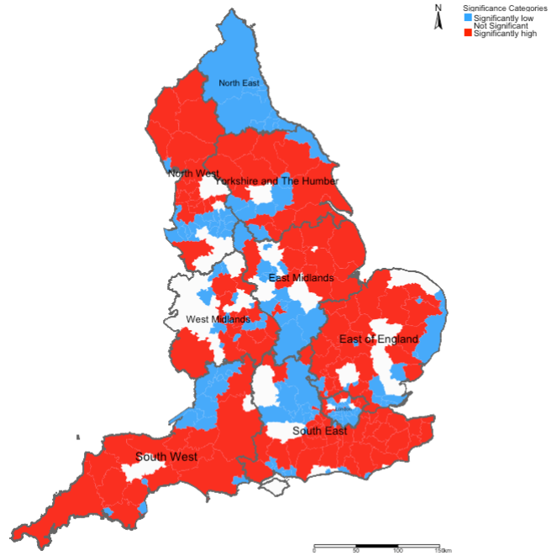
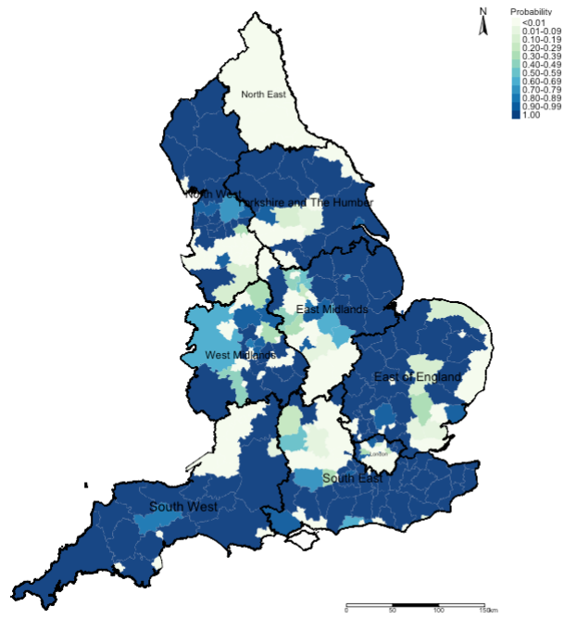
Relative risk ratios (RR)
Statistical Significance
Exceedance Probabilities
Here, we use this output to describe the burden of an outcome
This output is to valid whatever hypothesis we had about the described outcome’s burden in the first map
This output is used to describe the uncertainty that surrounds the risks we found in the first map
27

Slide 28
Relative risk ratios (RR)
Statistical Significance
Exceedance Probabilities
Interpretation: We can see that the risk patterns for road accidents across England are quite heterogeneous. While it is quite pronounced in all 10 regions in England, the burden is quite significant in South West region with large numbers of local authorities having an increased risk which are statistically significant. Perhaps, the Department for Transport should do an investigation on these patterns starting with the South West area.
28

Slide 29
Any questions?
29

